Slide 1

“Techno-Social Excellence”
Marathwada Mitra Mandal’s Institute of Technology Lohgaon, Pune-47
Department of Robotics & Artificial Intelligence
Community Engagement Project Presentation
On
“Title of the project”
By
1. Roll No. Name of Student
2. Roll No. Name of Student
3. Roll No. Name of Student
Under the Guidance of
Prof.

Slide 2
Contents
1. Title (All Times new roman- 28)
2. Introduction
3. Literature review
4. Problem Statement
5. Objectives
6. Methodology
7. Time line
8. Excepted Outcomes
9. References

Slide 3
Title of the project
Instructions : Use font size 20 of Times new roman for other contents
Slide May contain only
Readable Diagrams/figures/charts with proper titles
3 to 5 topic headers with bulleted points per slide
No long sentences and paragraphs
Follow line spacing of 1.5 between two consecutive lines

Slide 4
Introduction

Slide 5
Literature review
Refer below table as example
AUTHOR | WORK | FINDINGS | REMARKS
Narayanasamy et al (2007) | Suitability of Interstitial Free(IF) steels for press forming operations analyzed. | Tensile properties (tensometer), formability(press) parameters correlated with FLD. Formability is good. | Sheets of different widths-thickness 0.6mm, 0.9mm, 1.2mm and 1.6mm- Sheet of 1.6mm is superior.
Velmanirajan et al (2012) | Numerical modeling of Al sheets formability using Response Surface Method(RSM). | Mathematical model tool to predict response – annealing temp, orientation or width, thickness-empirical relations evolved. | Al1350, Al8011, Al1145 1.2mm,1.5mm,1.8mm-Model predicted in agreement with experiments.
Jianguang et al (2013) | FLD prediction of sandwich sheets. | Numerical simulation-GTN damage model-punch dome test-FLD-Validated. Core thickness influence studied. | AA5052/polyethylene/AA5052. Formability better than monolithic sheet.

Slide 6
Problem Statement

Slide 7
Objectives

Slide 8
Methodology

Slide 9
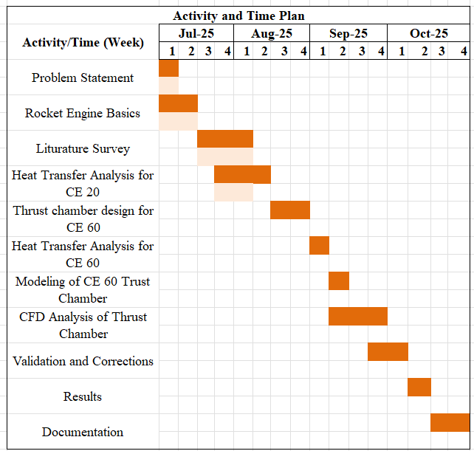
Time line
Refer below table format as example

Slide 10
Excepted Outcomes

Slide 11
References
Refer below reference format as example
[1] Author, “Title”, Name of Journal/Transactions/ Book, Edition/Volume, Publisher, Year of Publication, pp.__.

